Slide 1
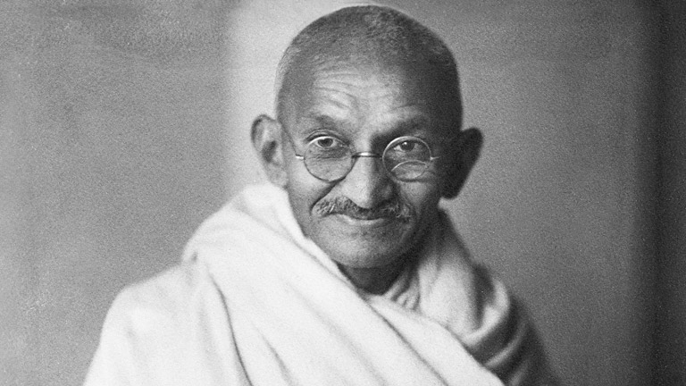
Gandhi 1869.-1948.

Slide 2
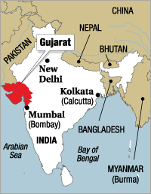
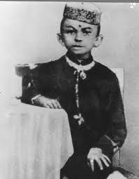
Early life
Born as Mohandas Karamchand Gandhi
on 2 October 1869 in Porbandar, Gujarat
His father, Karamchand Gandhi,
was the diwan(Prime Minister)
Studied law at the University
College London to become a
barrister

Slide 3
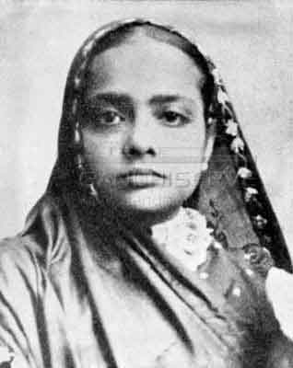
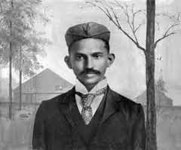
MARRIAGE
Married to Kasturba at the age of 13 in 1882.
Arranged marriage
4 sons(Harilal,Manilal, Ramdas and Devdas Gandhi)

Slide 4
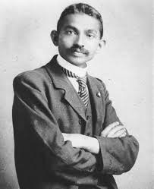
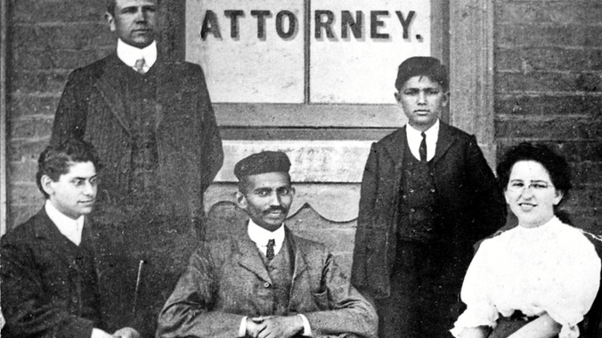
A young lawyer
failed to establish his own law practice in Bombay
a part-time job as a high school teacher,
Rajkot → a modest living, drafting petitions for litigants, a business he was forced to close when he ran afoul of a British officer.

Slide 5
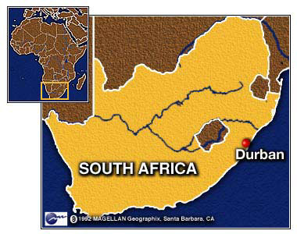
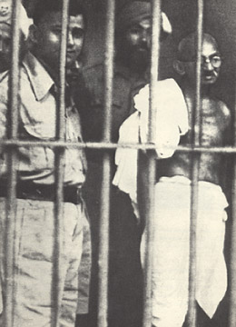
A social activist
Two years later, 1893,accepted a job as
a legal adviser of an Indian firm in Durban.
Faced discrimination against Indians.
Thrown out of a train in
Pietermaritzburg → a turning
point → became a social activist
Remained for 20 years
Often Imprisoned

Slide 6
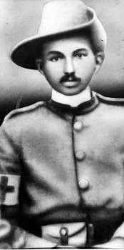
Ghandi in south africa
Ambulance Corps Unit -the Boer War
1899-1892 and the Zulu War of 1906
- supported the British government so
he could gain full citizenship for Indians
in South Africa,but didn’t achieve that
goal.

Slide 7
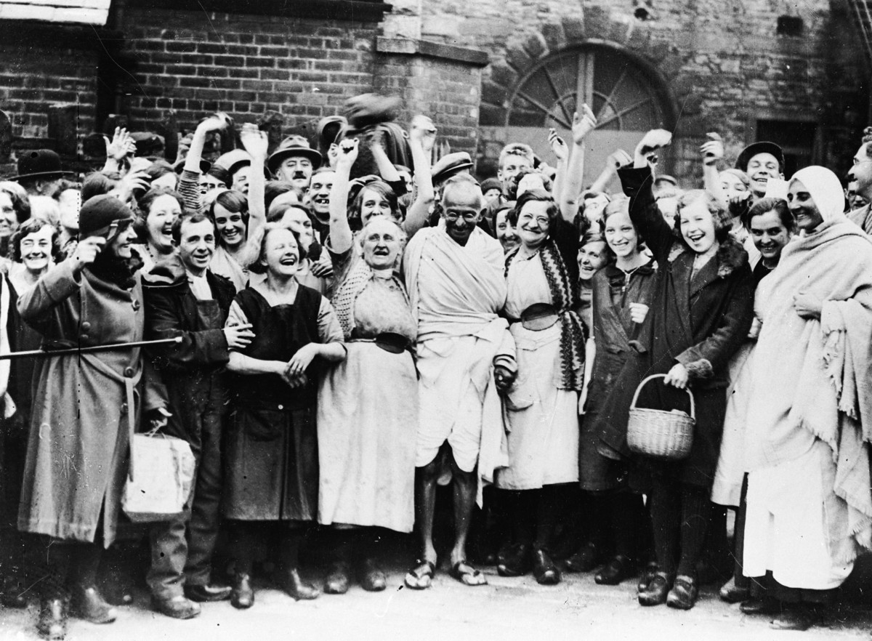
Ghandi and the women
Women were uneducated
and opressed
Supported them and
improve their role in society
along with Kasturba
Enlisted them in his campaigns such as Salt March and boycott of foreign products
- Result: self-confidence and dignity in public life

Slide 8
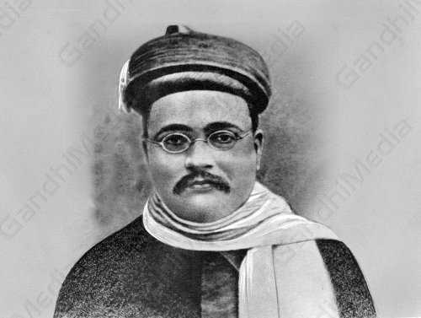
Fight for the independence of india
1915. - returned to India
Gopal Krishna Gokhale,a
respected leader of the Congress
introduced him to Indian issues,
politics and the Indian people Party
thousands of people opressed and farmers forced
to grow indigo and other cash crops instead of food crops

Slide 9
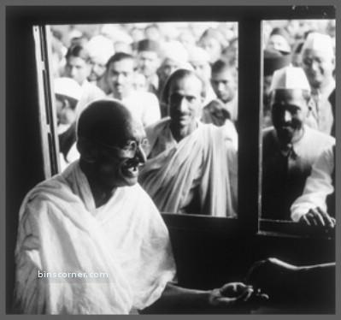
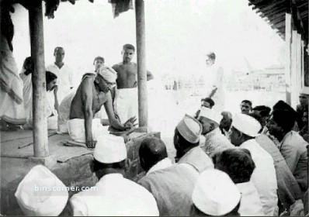
satyagraha
a new non-violent way to make things right
lots of people disobey unfair laws, uncooperative with rulers who were treating them badly.
“There are many causes that I am prepared to die for, but no causes that I am prepared to kill for.’

Slide 10
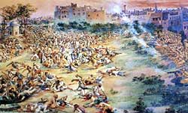
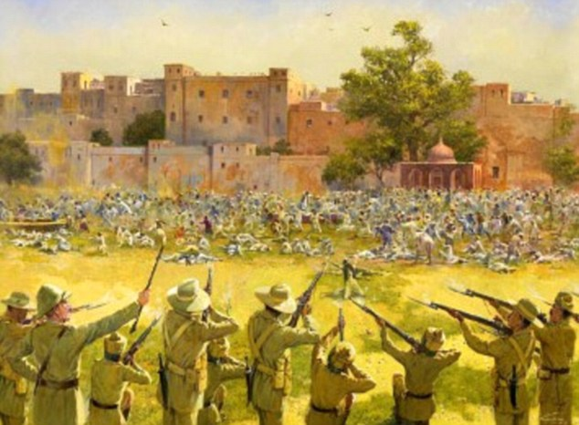
Rowlatt acts
In 1919, Parliament approved the Rowlatt Acts
- gave authorities emergency powers to deal with revolutionary activities.
Activities against the Rowlatt Acts →resulted in a massacre of Indians at Amritsar by British soldiers.
1,516 casualties.

Slide 11
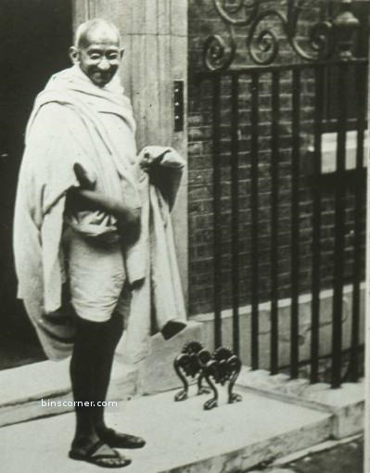
Trip to london
Became internationally known
Couldn’t be harmed in any way
(hunger strike or death) while
arrested
Became respected world figure
without violence.
The British couldn’t ignore him so
they had to talk with him.

Slide 12
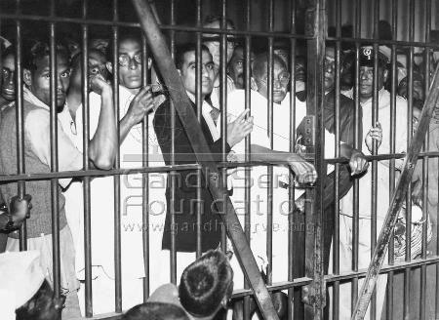
imprisonment
Arrested on 10 March 1922,
sentenced to six years.
Released in February 1924.
The consequences were that the Indian National Congress began to splinter and cooperation between Hindus and Muslims was breaking down

Slide 13
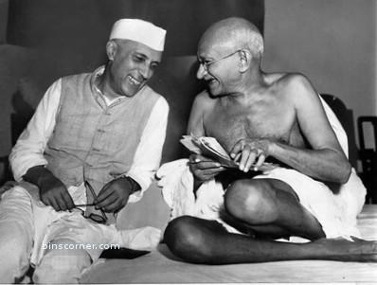
The independence delay
WWII was interrupting the independence plan.
India couldn’t have been a part of a war being fought for democratic freedom, while that freedom was denied to India itself.
Persistent for the independence → demanded the British to leave India.
Gandhi and Jawaharlal Nehru working on the independence plan

Slide 14
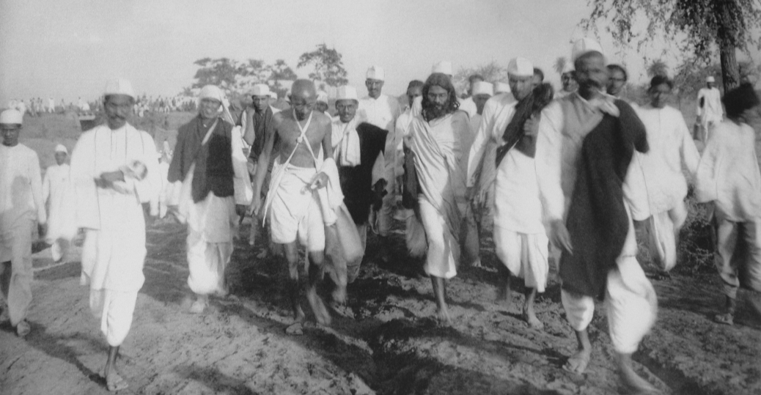
The salt march
On March 12, 1930 he started a trip from his ashram to the town of Dandi long 240 miles
Spoke and prayed on the coast with his followers,then started making salt as a protest against salt taxes.

Slide 15
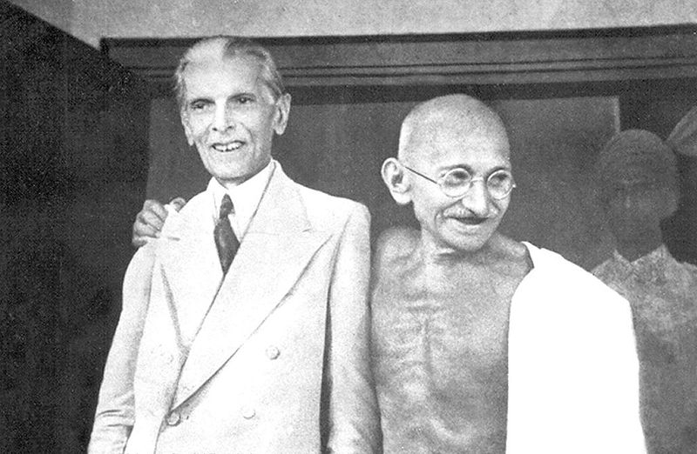
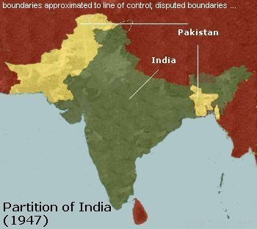
The big event
By 1944, the British government agreed to independence if the two religious groups resolve their differences.
India divided on India and Pakistan after the British agreed to independence in 1947.

Slide 16
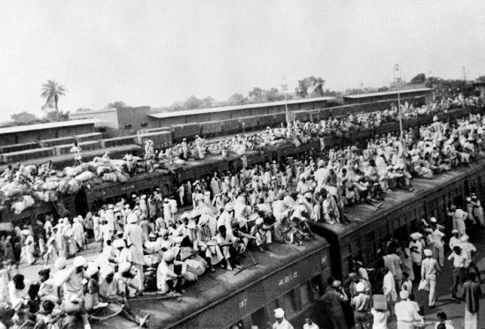
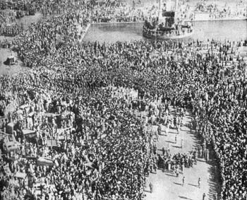
Conflict between muslims and hindus
In border areas around 500,000 people were killed in riots between Hindus and Muslims
Dissapointed with the fights,Gandhi started his fast which stopped when representatives of all the communities signed a statement that they were prepared to live in peace.

Slide 17
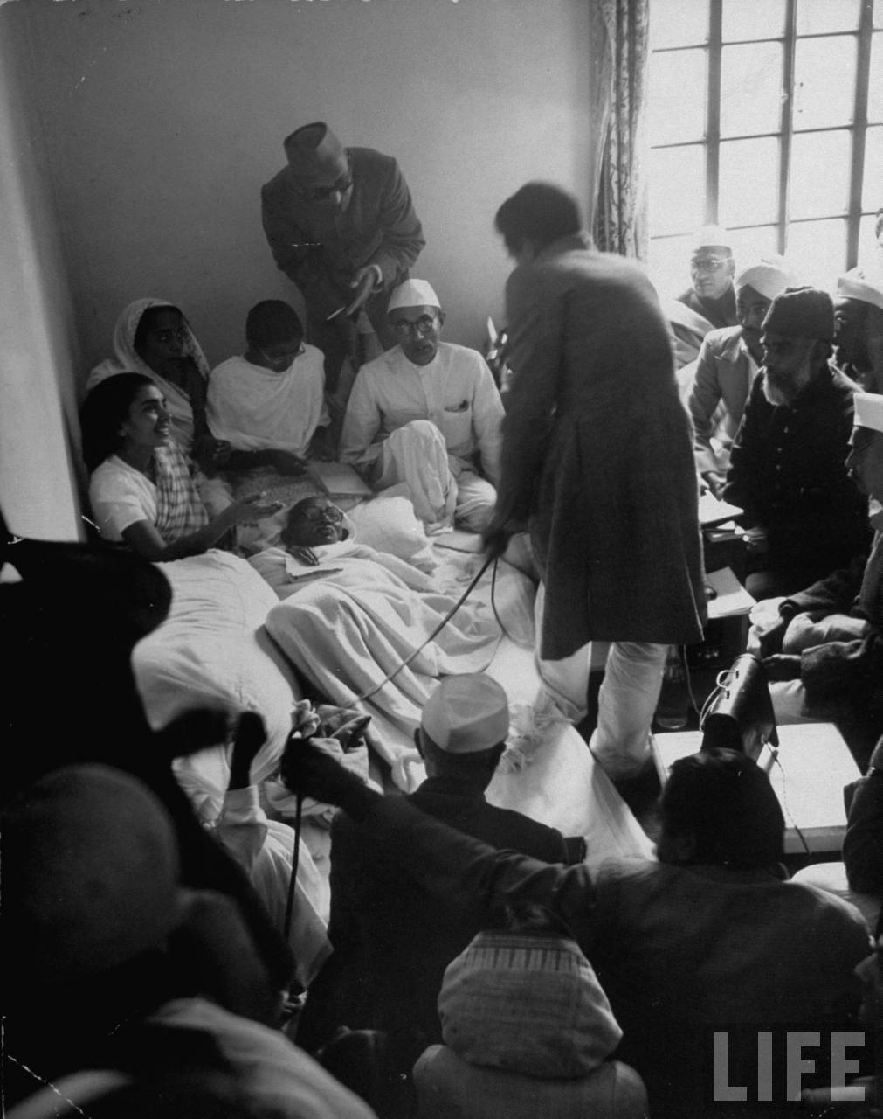
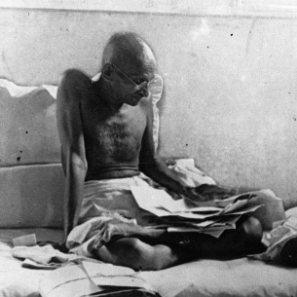
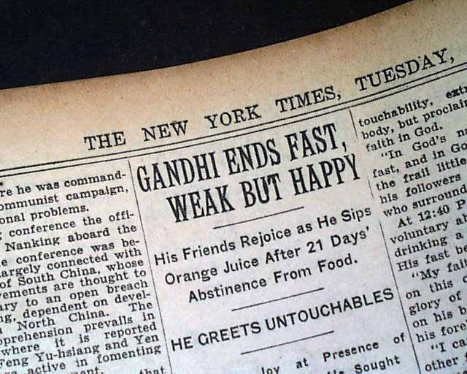
Hunger strikes and fasting

Slide 18
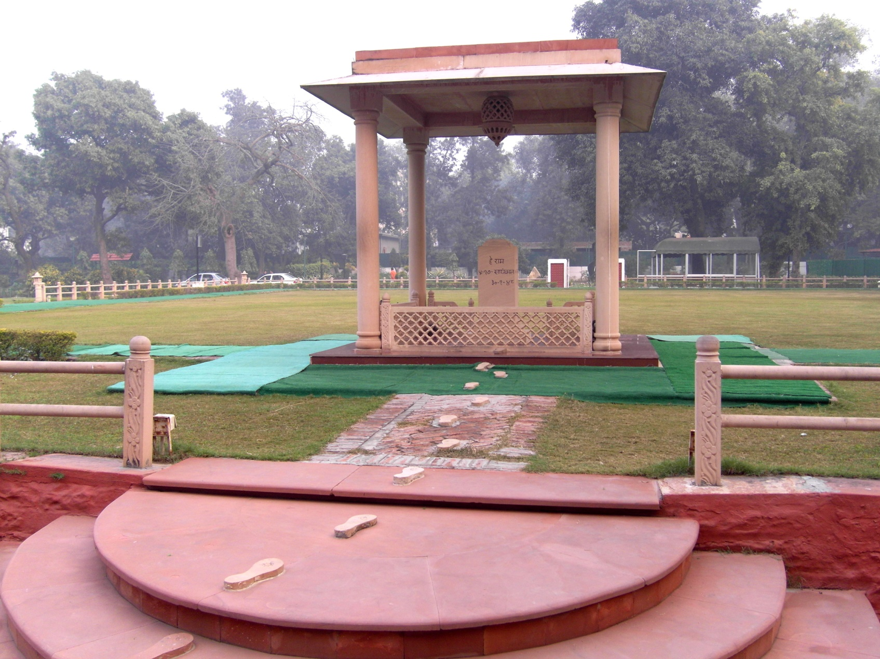
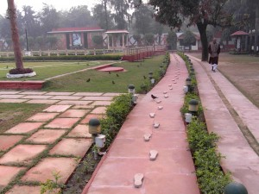
Gandhi’s death
Refused additional security – moved around unprotected
30 January 1948, meeting with India's Deputy Prime Minister and Vallabhai Patel

Slide 19
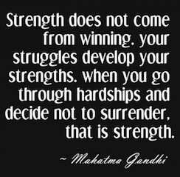
His influence
Respected by his followers
Called “The Father of the Nation” “Mahatma” which translates into “Great Soul”.
His birthday, October 2nd, is a public holiday in India.

Slide 20
Interesting facts about gandhi
Hated cinema. Didn’t think cinema is a medium to propagate his ideals.In his last years, he started using radio
Hated photographers and taking photos despite he was the only person hugely photographed.
During the Salt March of 1930, at the age of 60, he walked 241 miles.
Lived a spiritual and ascetic life of prayer, fasting and meditation.
He wore the clothes of the poorest Indian.

Slide 21
THE END!
Thanks for your attention ☺

