Slide 1
William Shakespeare

Slide 2
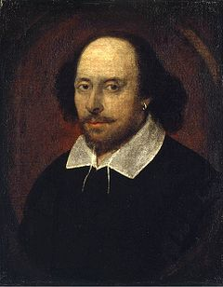
William Shakespeare
-born - Straford upon Avon 26 April 1564
- died – Straford upon Avon 23 April 1616

Slide 3
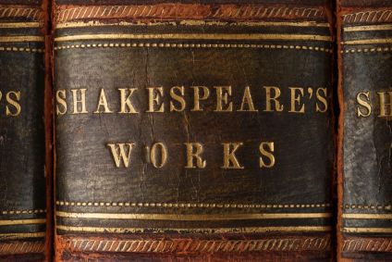
Surviving works:
- 38 plays
- 154 sonnets
- 2 long narrative poems
- several other poems

Slide 4
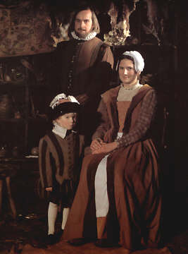
At the age of 18, he married Anne Hathaway
Children: Susanna, and twins Hamnet and Judith

Slide 5
1585 - 1592 - successful career in London
- actor
- writer
- part owner of a playing company called the Lord Chamberlain's Men, later known as the King's Men.

Slide 6
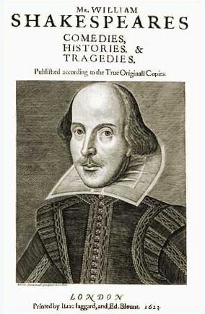
Shakespeare‘s works
- Tragedies: Hamlet, Romeo and Juliet, Othello, King Lear
- Comedies: The Merry Wives of Windsor, The Tempest, As You Like It
- Histories: King John,
Richard III, Henry V,
Henry VII

Slide 7
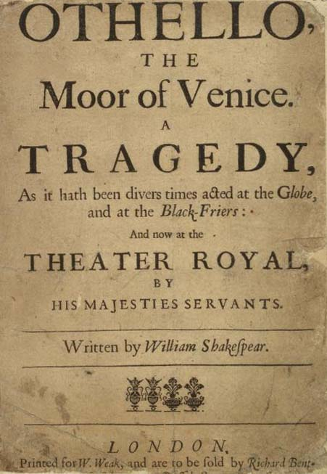
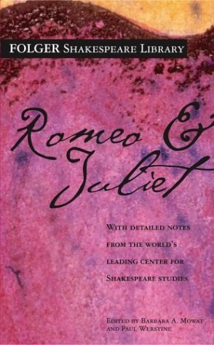
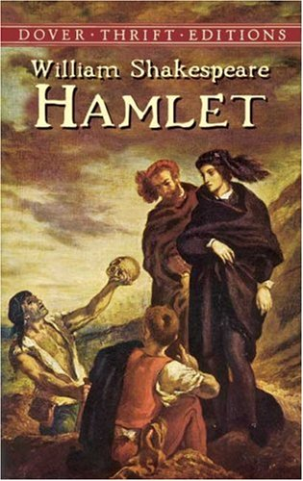
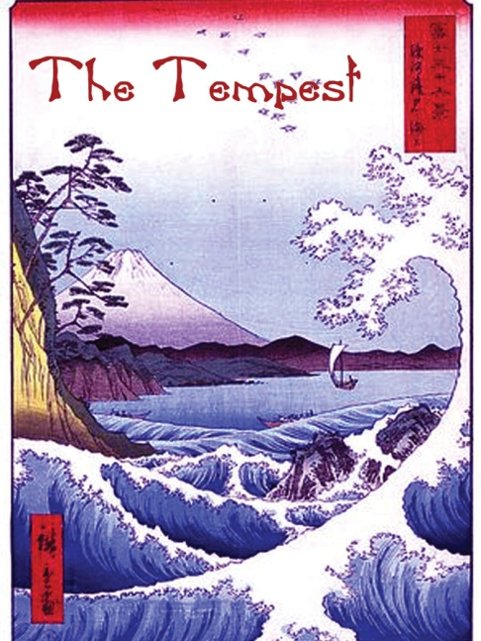

Slide 8
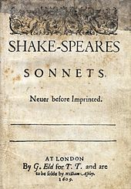
Shakespeare‘s sonnets
14 lines – 4 stanzas – 4/4/4/2- the message, ussually – 4/4/3/3

Slide 9
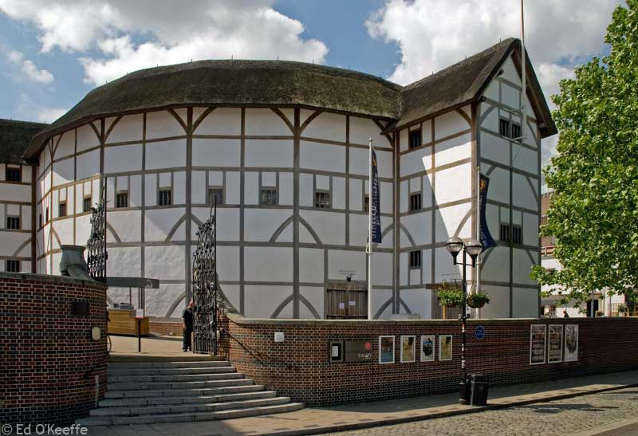
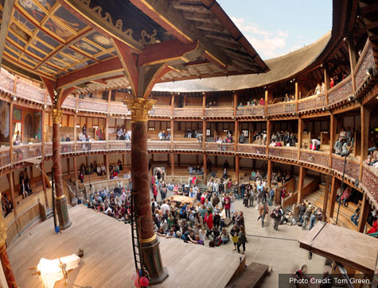
Shakespeare‘s theatre
No scenography
All shows were played by men
Elaborate costumes
Globe theatre:

Slide 10
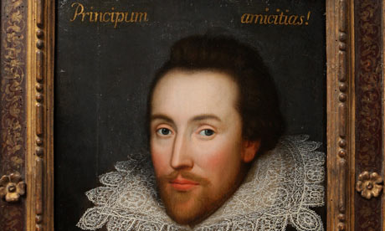
Shakespeare's plays continued to be staged after his death

Slide 11
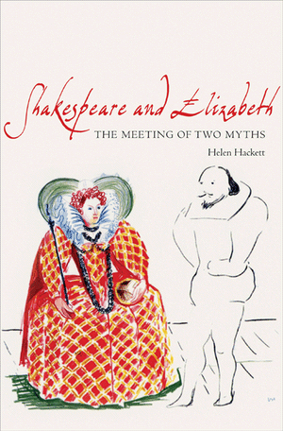
Shakespeare and Queen Elizabeth
Queen Elizabeth - Shakespeare’s patron
They were in good relationship because Queen was supporting him

Slide 12
The end

